Slide 1




Saudi Solar Vision
Shining a Light on Tomorrow
Presented by Dina, Meshael, Rewaa, Raghad

Slide 2


Slide 3





Solar Energy Statistics in Saudi Arabia
24 MW
34 MW
109 MW
439 MW
27.3 GW
2015
2017
2019
2021
2024

Slide 4


40 GW
2030

Slide 5
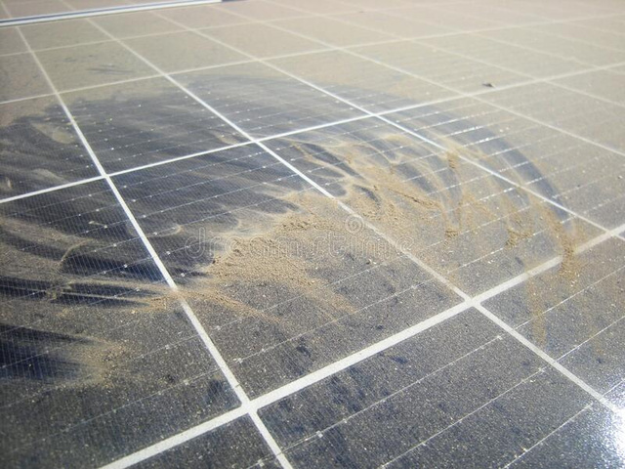
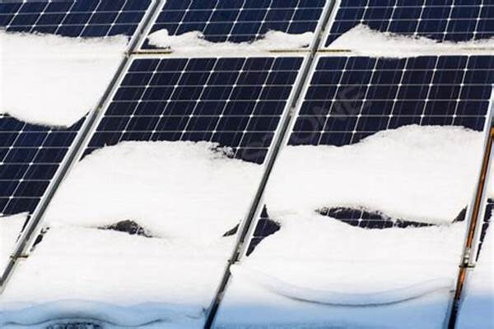
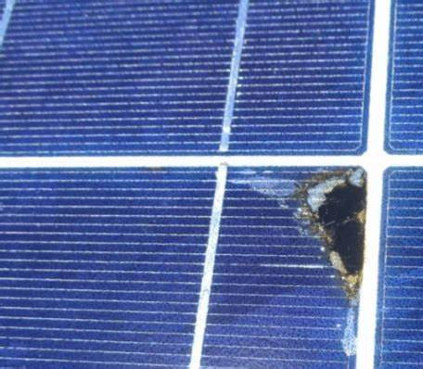

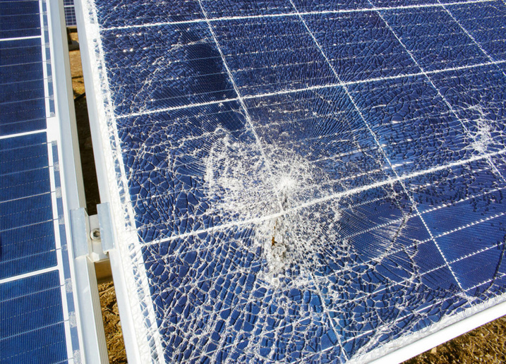
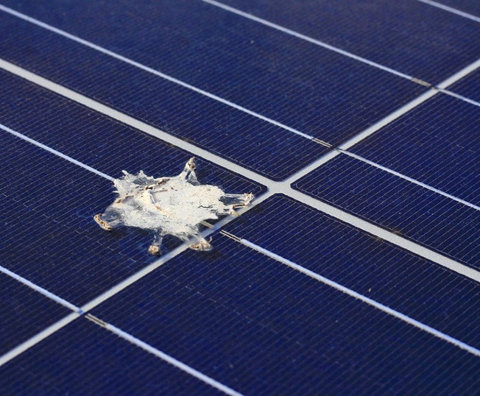
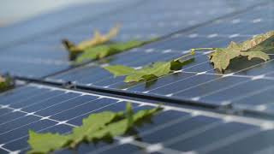

Slide 6
Our Data
Clean
Weather Damage
Electrical Damage
Physical Damage
Snow Covered

Slide 7
MobileNet for Solar Panels Status Classification
Accuracy
Loss
91.66%
0.39

Slide 8
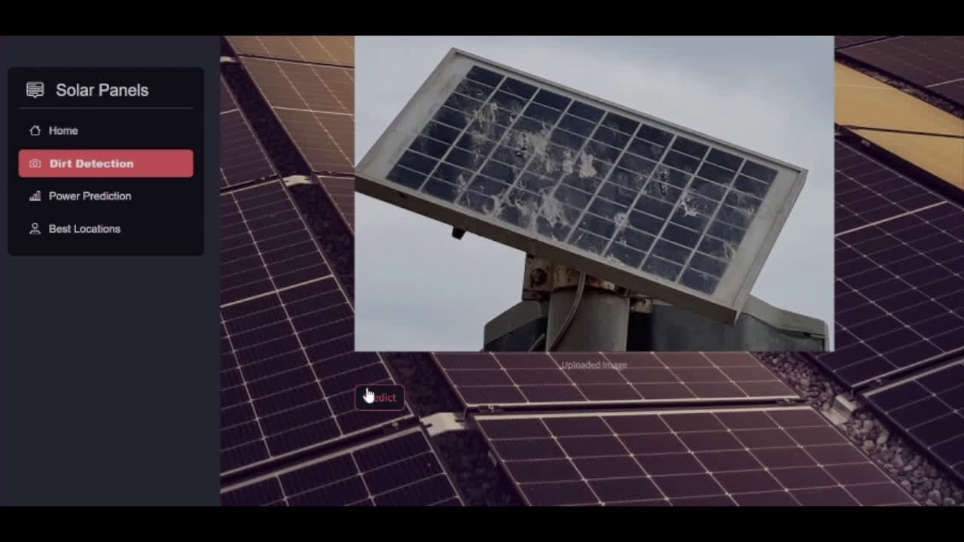
Demo

Slide 9

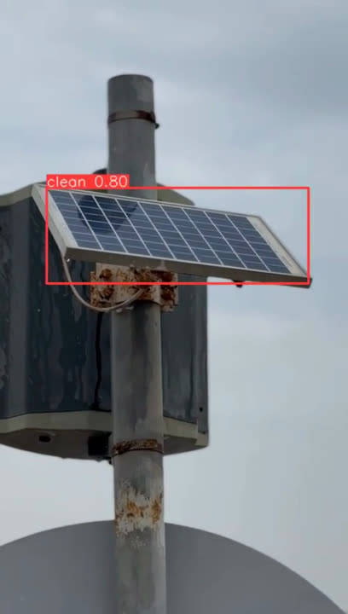
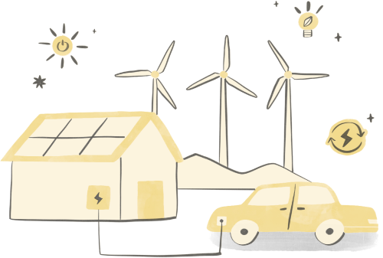
YOLOv8 for Solar Detection
Live Testing in Dammam

Slide 10


Location
Recommender
System

Slide 11
Does all locations on Earth receive the same amount of sunlight?

Slide 12
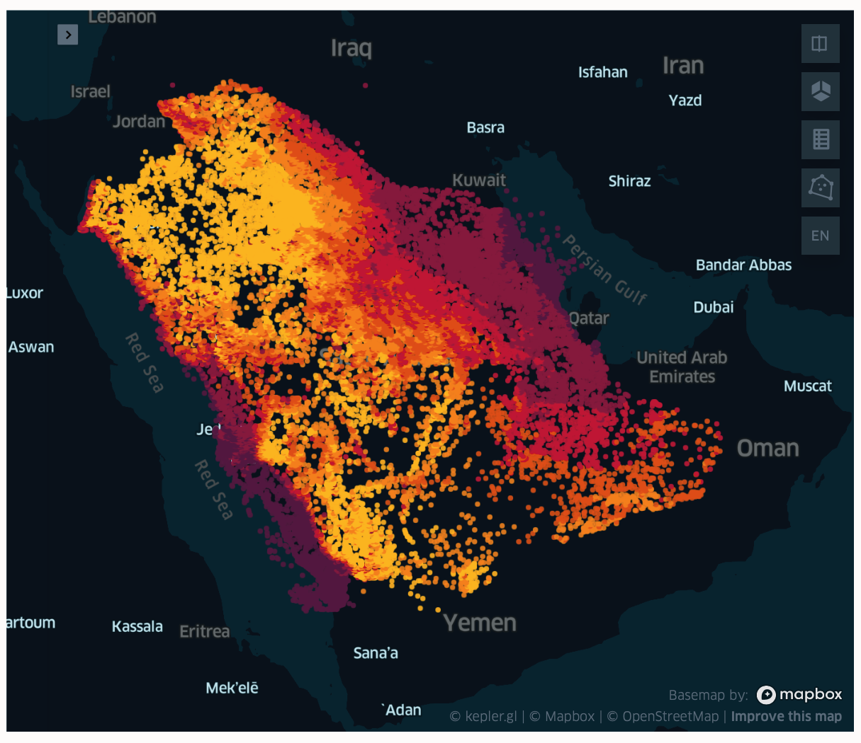
What is the best location ?
DNI: Direct Normal Irradiation
GHI: Global horizontal irradiation
DIF: Diffuse horizontal irradiation
Temp: Air temperature
PVOUT: Specific photovoltaic power output

Slide 13


Location Data
Source:
Global Solar Atlas
GeoNames

Slide 14
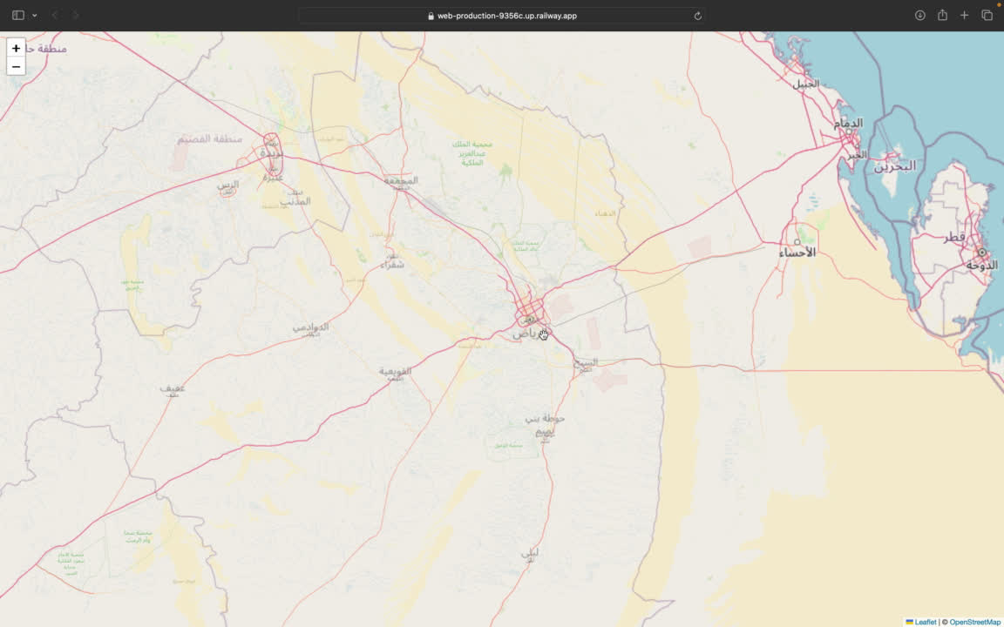
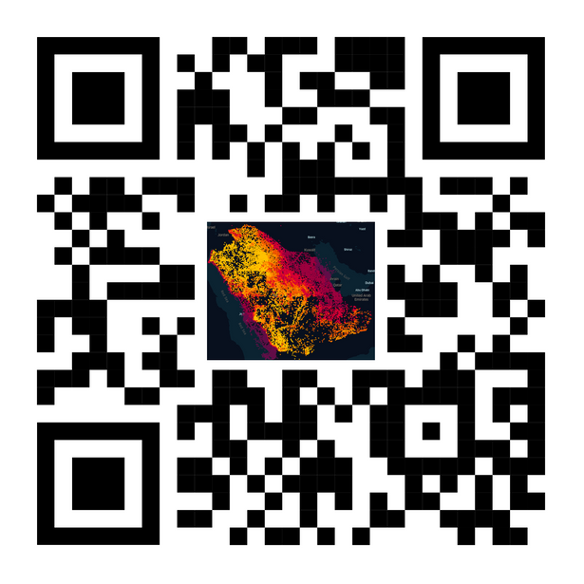
DEMO

Slide 15
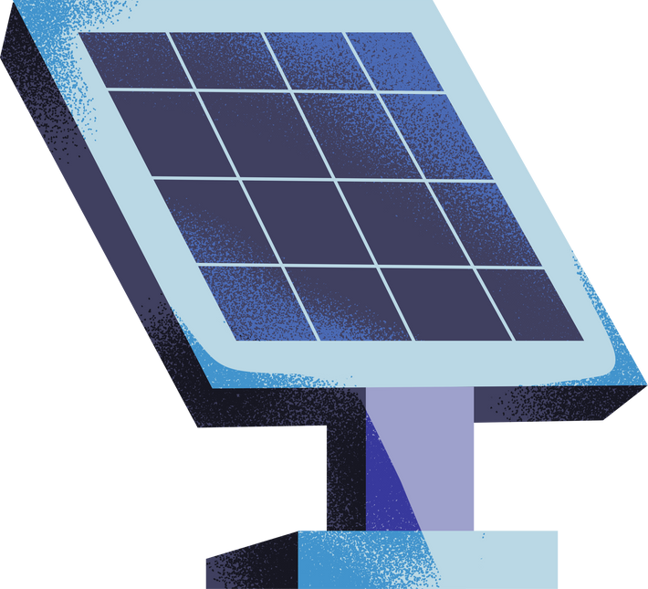
Predicting Generated Energy

Slide 16
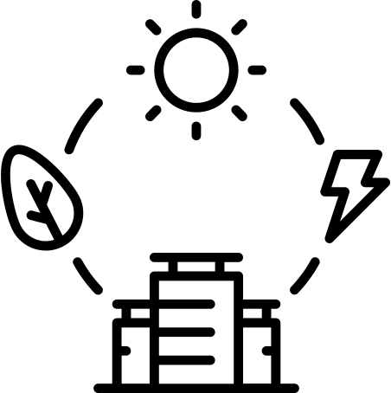
Solar Power Insights:
Predicting Solar Energy using Sensor Data
Our Features:
Our Target:
DC Power
Irradiation
Temperature
AC Power

Slide 17

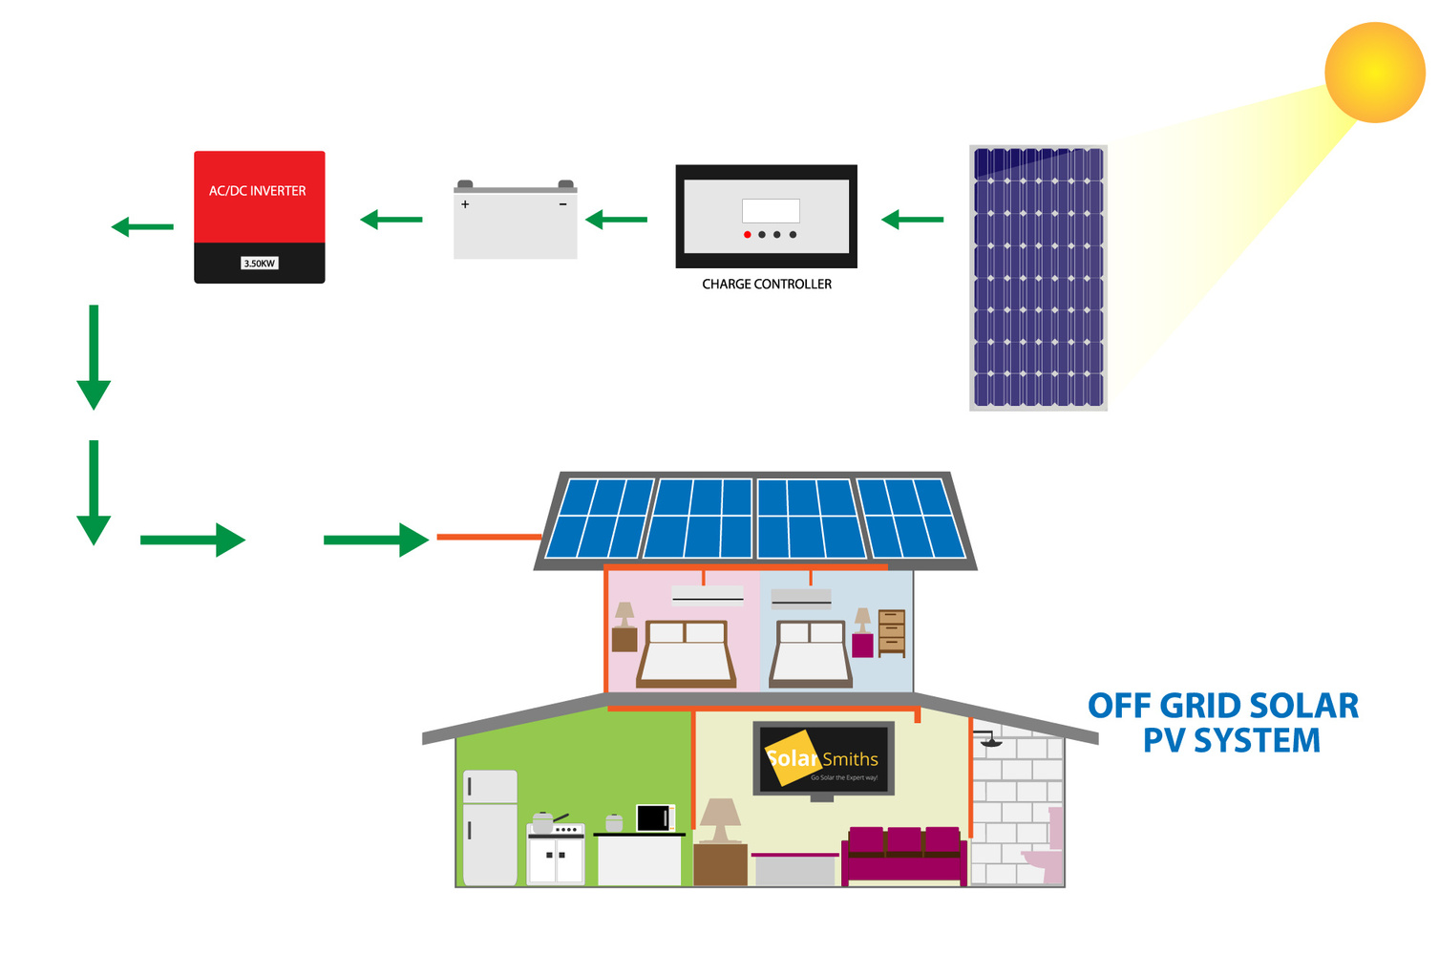
Why AC Power?

Slide 18
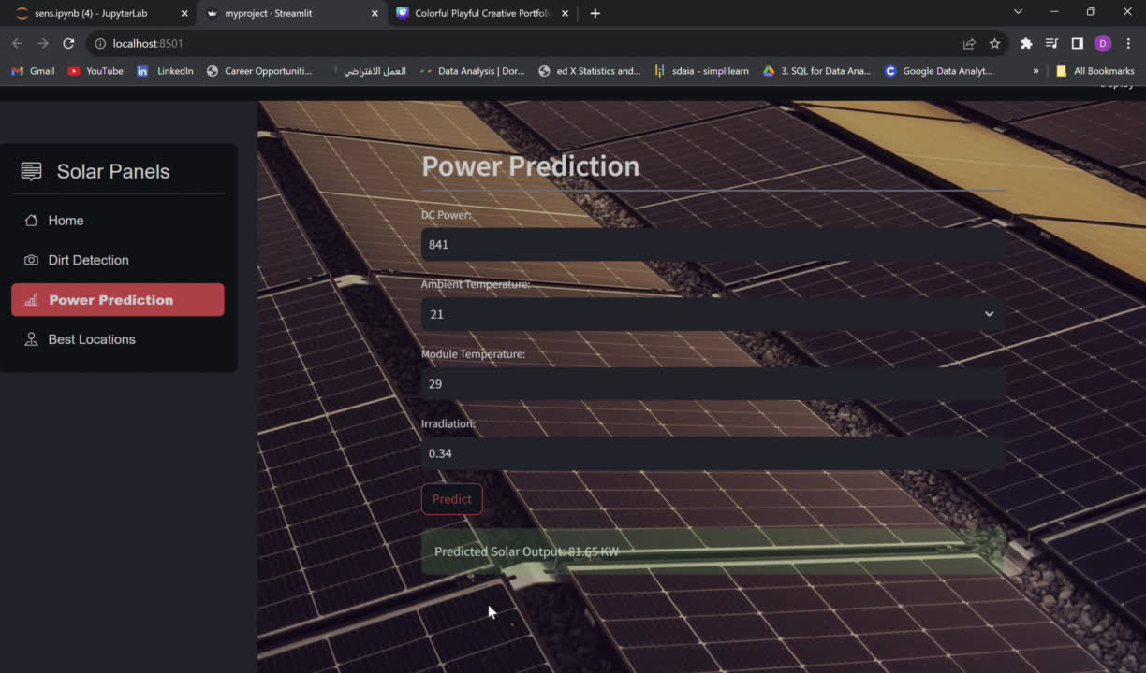
DEMO

Slide 19

Saudi Solar ChatBot

Slide 20

Saudi Solar ChatBot
DataSet
The dataset was compiled through manual collection from different URLs focusing on solar energy and Saudi projects.

Slide 21
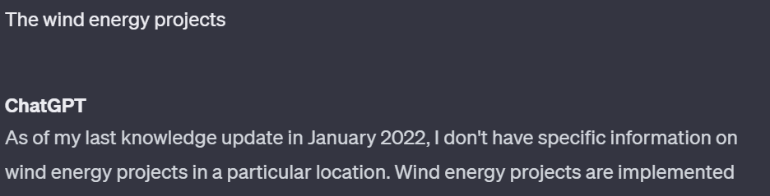
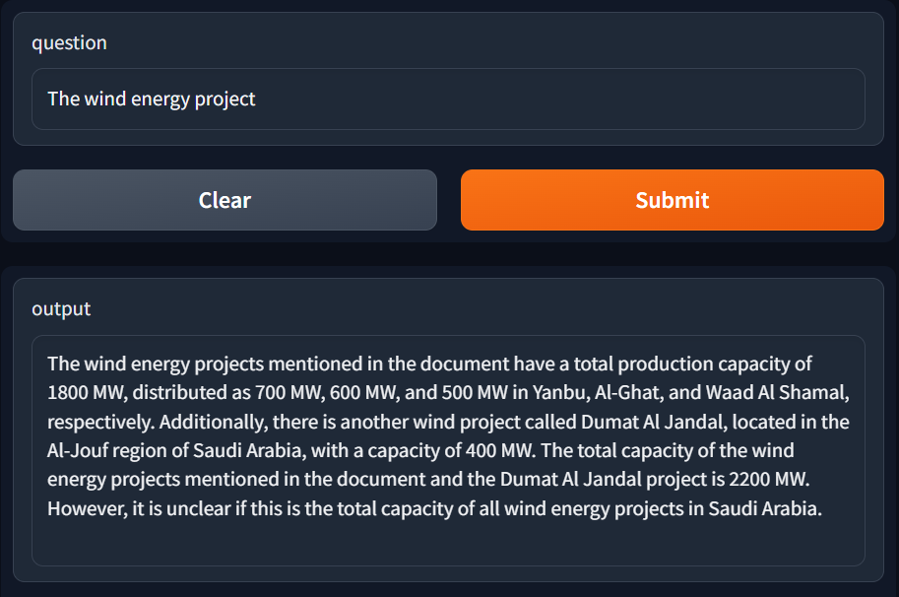
Saudi Solar ChatBot

Slide 22
Future work

Slide 23
Conclusion
Photovoltaic panels, key components in renewable energy, face efficiency challenges from dirt accumulation.
This aligns with the broader vision of transforming Saudi Arabia into a global hub for renewable energy and fostering innovation in the energy sector.

Slide 24

Thank you !

